Slide 1
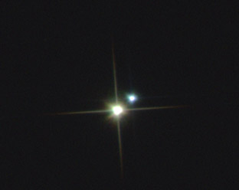
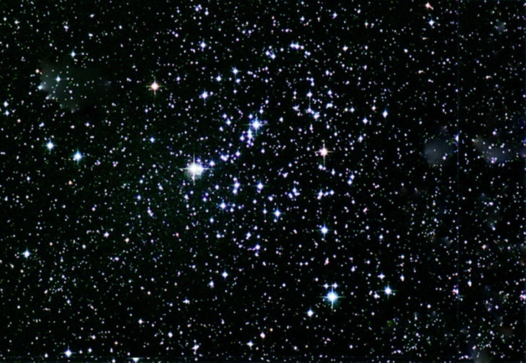
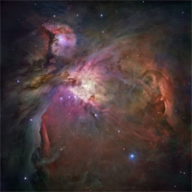

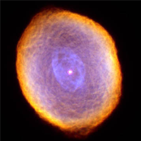

Slide 2
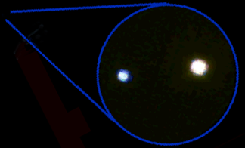
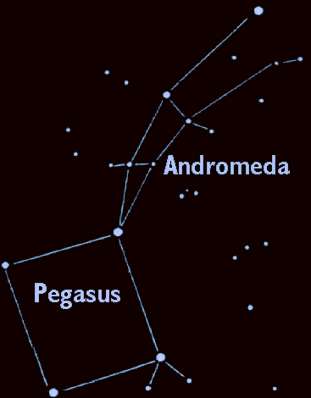
Gamma Andromedae
Through the Telescope
355 light years away in the constellation Andromeda –' the Chained Maiden'

Slide 3


A Pair of Stars
Gamma Andromeda (or Almach) when seen through the telescope is actually two stars.
Gamma 1
Gamma 2

Slide 4
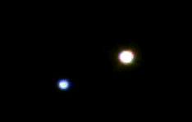

Star Pairs
Pairs of stars are one of two different types:
Optical Double Stars
Binary Stars

Slide 5

Optical Double Stars
Optical Double stars are just two stars that happen to lie in the same direction in the sky.
(A side view)
If you could see these stars from a different vantage point than Earth, you would see that they actually have nothing to do with each other.

Slide 6
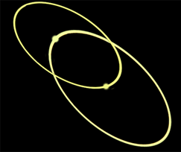

Binary or Multiple Stars
In a Binary (or Multiple) star system the stars are relatively close and orbit each other.

Slide 7

Multiple or Optical Double?
It's all in the distance.
Optical double stars are very large distances apart but appear to be close together because they are in the same line-of-sight.
Multiple stars lie close to each other in space and at about the same distance from Earth.

Slide 8
How Can You Find the Distance to a Star?
Earth
Nearby star
ρ
Background stars
Sun
d
ρ
Apparent positions of the nearby star for observations taken 6 months apart.
The position of a nearby star from different sides of our orbit around the Sun make it seem to shift in the sky. This shift, called parallax, can be used to find the distance to nearby stars.

Slide 9
Gamma Andromeda
The stars of Gamma Andromeda turn out to be “only” 60 billion miles (0.01 light years) apart, making it a binary star system.
Gamma 1
Gamma 2

Slide 10
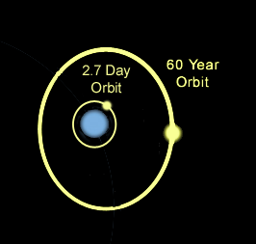
Gamma 2 - A Triple Star System!
But wait! If we could look more closely at Gamma 2 we would find two stars very close together orbiting each other every 2.7 days and a third star, much farther out, orbiting the other two every 60 years.

Slide 11
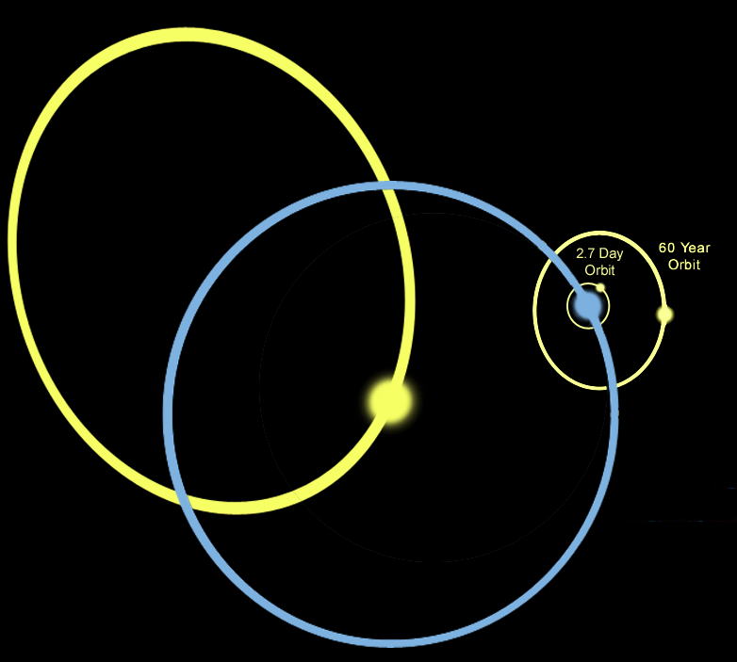
Gamma Andromeda - A 4 Star System!
So, Gamma Andromeda is actually a 4 star system.
Multiple star
systems are very common in our galaxy.

Slide 12
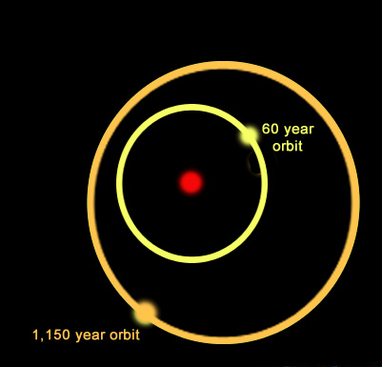
Multiple Star Systems
Star systems come in many varieties. For example, the system shown here is a triple star system:
A yellow star orbits a primary star with a period of nearly 60 years while a more distant companion orbits the inner pair with a period of 1,150 years.
One multiple star system we know of has 9 stars!

Slide 13
Stars Can Be Different Colors
Stars form with different amounts of hydrogen. High-mass stars have lots of hydrogen so they burn hotter and faster than stars with less fuel.
Thus a high-mass star has a different temperature, color and life-span than a low-mass star.

Slide 14
Contrast Multiple Stars
A multiple star system can have different colored stars orbiting each other. Here is one with a blue star and a yellow star
Blue stars are more massive and hotter than yellow or red stars. Stars of different masses evolve differently.

Slide 15
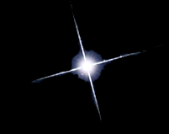

Types of Middle-Aged Stars
Blue stars are
high-mass hot stars.
Yellow stars, similar to our Sun, are average in mass and temperature.
Red stars are
low mass and cool.

Slide 16
Contrast Multiple Stars
Can you identify:
Which star is brightest?
Which star is hottest?
Which star is largest?

Slide 17
Contrast Multiple Stars
The blue star is the hotter of the two, yet the yellow star is the brightest and the largest.

Slide 18
Contrast Multiple Stars
But wait … how can the yellow star be brighter if it’s putting out less heat?

Slide 19
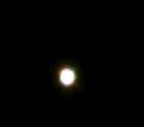
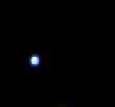
How can that be?
There are two possibilities: The cooler star may be nearer to us or it may be larger.
But since we know the two stars are about the same distance from us, the yellow (cooler) star must be larger.

Slide 20
Contrast Multiple Stars
Therefore, since Gamma 1 is brighter, but cooler, it must be larger than Gamma 2.
Gamma 1 is starting to die, and dying stars swell, turning into a giants.

